Slide 1


IntelleTect
Supervisor
Ms. Noor ul Ain
Automatic House Design from linguistic Descriptions
i191652
i191660
i191787
Momin Shahzad
Ali Raza
Muhammad Umer

Slide 2



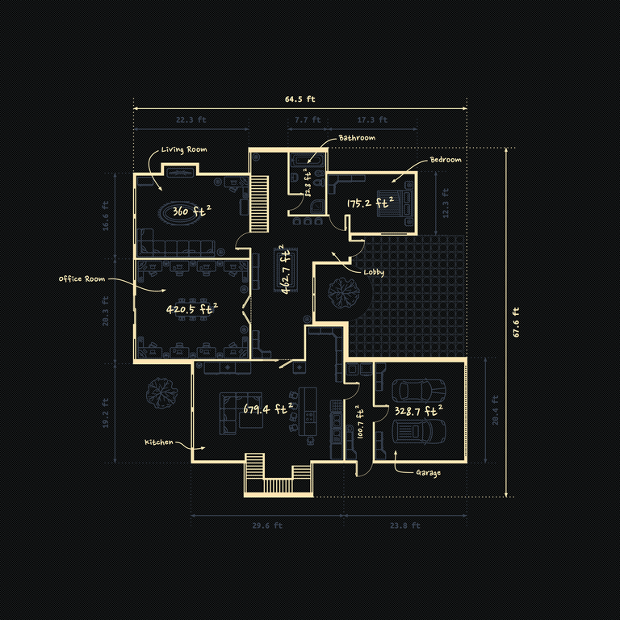
IntelleTect
Project Intro
Audio Input
Voice to text
Floor Plan Generation
Takes in Voice input
Converts into textual description.
Maps it according to labels.
Generates House plans based on descriptions
Displays plans on front-end

Slide 3



Motivation
IntelleTect
01
02
03
Easy to Use
Saves Money
Custom House Plans
No need for prior experience in the felid, "Anyone can use it"
No need to hire professional architects and waste thousands of cash
Just say what you want and it'll design it just for you.

Slide 4


Problem Statement
1
Complexity
2
Experience/Skill Needed
3
Expensive

Slide 5
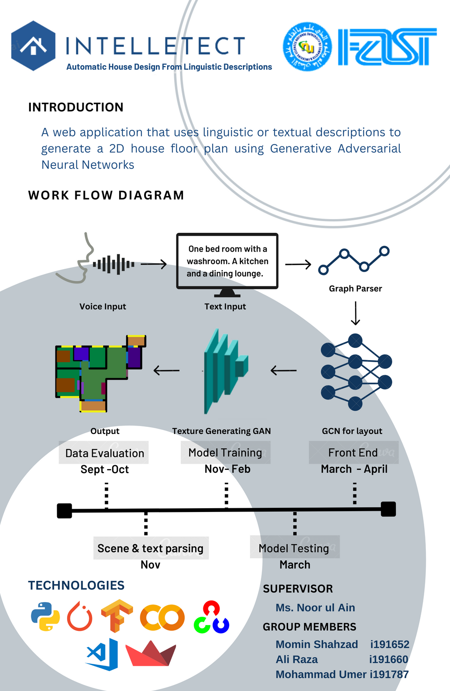
Project Poster
Practical features of the project are explained in the following poster.
1
High Level Architechture
2
Project timeline

Slide 6




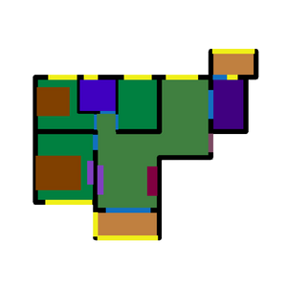
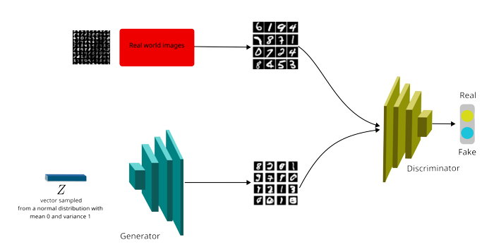

One bed room with a washroom. A kitchen and a dining lounge.
Graph Parser
Voice Input
Text Input
Architechture
Output
Texture Generating GAN
GCN for layout
1
Input mapping
2
Layout Generation

Slide 7

Project Timeline
MODEL TESTING
Feb-april
FRONT END
april - may
DATA EVALUATION SEPT -OCT
MODEL TRAINING
Nov- Feb
Testing Components
Merging all the component, deployment, Testing and improvements.
INPUT PARSING
OCT-NOV
Training the model
Collecting Data and configuring it to fit the model (masking)
Parsing the input text into labels for the model

Slide 8
Work Done Till Now
IntelleTect
01
02
03
04
Iteration 1
Iteration 2
Iteration 3
Iteration 4
Collecting Data and configuring it to fit the model (masking)
Parsing the input text into labels for the model
Training the GCN
Training a Texture Generating GAN and Front End

Slide 9


Work till FYP-1 Final
A semi-trained version of the
GCN generated images

Slide 10
IntelleTect
References
Chen, Q., Wu, Q., Tang, R., Wang, Y., Wang, S., & Tan, M. (2020). Intelligent Home 3D: Automatic 3D-House Design from Linguistic Descriptions Only. 14.
(Simon Fraser University)(Autodesk Research) [CVPR 2020]
Nauata, N., Chang, K.-H., Cheng, C.-Y., Mori, G., & Furukawa, Y. (2020, march 16). Networks for Graph-constrained House Layout. 17.
( South China University of Technology) (Guangzhou Laboratory) (Australian Centre for . Robotic Vision) (University of Adelaide, Australia) (Springr ECCV 2020)
Nauata, N., Hosseini, S., Chang, K.-H., Chu, H., Cheng, C.-Y., & Furukawa, Y. (2020). House-GAN++: Generative Adversarial Layout Refinement Network towards Intelligent Computational Agent for Professional Architects. 10.
(Simon Fraser University)(Autodesk Research)

Slide 11
DEMO

